Slide 1
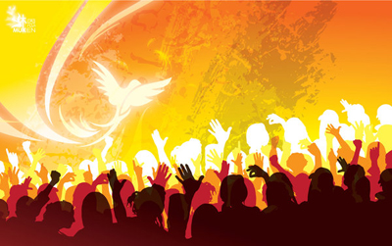
A Spirit of Justice, Love and Peace
Moved by Grace to confront Racism
The Challenge of Racism Today: Confirmation Lesson

Slide 2
What words come to mind when you think about Confirmation?

Slide 3
What words come to mind when you hear the word: RACISM?

Slide 4
Racism is not part of God’s plan
Made in God’s Image and Likeness
We are all children of the same loving God who brought us into being
No one is better than another person because of the color of their skin or the place of their birth.
Each person should be seen in his or her uniqueness as a reflection of the glory of God and a full, complete member of the human family.

Slide 5
How can faith change this vision?

Slide 6
Confirmation empowers us to live as Jesus’ disciples
https://www.youtube.com/watch?v=cteMjwOBPtw

Slide 7
The gifts of the Holy Spirit that make it possible for us to lives our lives for and with God.
Wisdom – the ability to see everything and everyone from God’s point of view
Understanding – the ability to look beyond the outward appearance of reality to comprehend God and his plan for salvation
Counsel – makes us sensitive to the voice of the Spirit to guide ourselves and others to do the will of God
Fortitude – the strength to endure and have courage in ordinary daily life and in times of difficulty
Knowledge – leads us to know the greatness and love of God through all creation
Piety – relates to our relationship with God and allows us to pray and worship God in love and simplicity
Fear of the Lord – joyful awareness of the glory and power of God and grateful realization that only in him can our hearts find real peace

Slide 8
Gifts of the Holy Spirit
Working in pairs: Think about the Gifts of the Holy Spirit that you received at Baptism and that will be strengthened in you at Confirmation.
Which of these gifts do you see most strongly in your partner? Write the gift on a piece of paper and give the paper to your partner.
Wisdom
Understanding
Counsel
Fortitude
Knowledge
Fear of the Lord
Piety

Slide 9
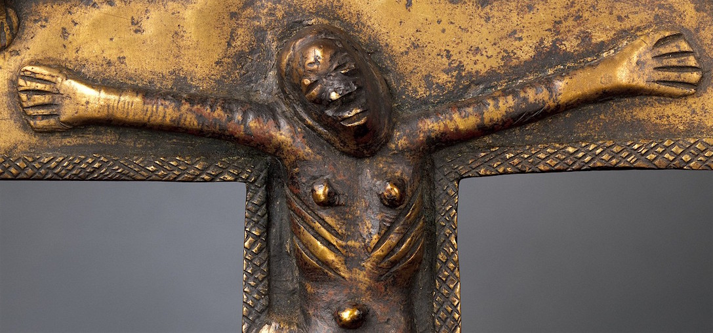
Intolerance and racism are not part of God’s plan.
Group Activity:
Break into groups according to the Gift of the Holy Spirit that was assigned to you.
As a group:
Discuss how this gift can help confront racism
Name one way your gift of the Holy Spirit can transform racism with love and peace
Be prepared to share your action item with the class

Slide 10
Closing Prayer
Lord, make me an instrument of Your peace.
Where there is hatred, let me sow love;
where there is injury, pardon;
where there is doubt, faith;
where there is despair, hope;
where there is darkness, light;
where there is sadness, joy.
O, Divine Master,
grant that I may not so much seek
to be consoled as to console;
to be understood as to understand;
to be loved as to love;
For it is in giving that we receive;
it is in pardoning that we are pardoned;
it is in dying that we are born again to eternal life.
Amen.
Prayer of
Saint Francis of Assisi

